Slide 1
Family

Slide 2
Wife and
husband

Slide 3
Mother

Slide 4
Father

Slide 5
Daughter

Slide 6
Son

Slide 7
Brother and Sister

Slide 8
Grandmother

Slide 9
Grandfather

Slide 10
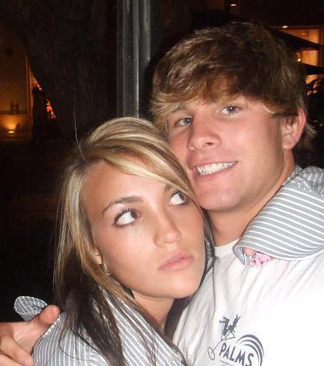
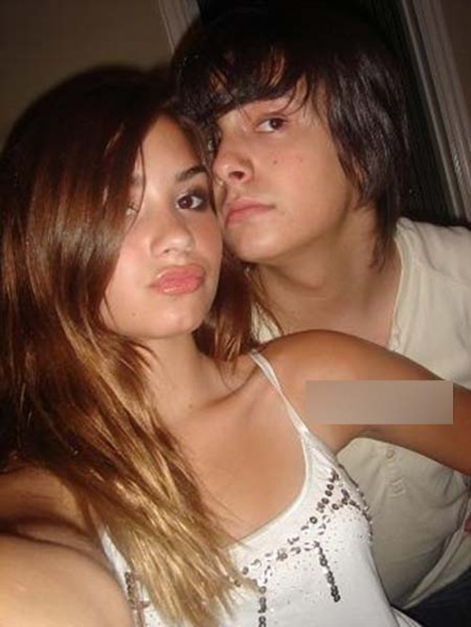
Girlfriend and boyfriend

Slide 11
How old is ______(name)?
____(name) is ___ years old.
When was _______(name) born?
____(name) was born in ____(year)
Who has a husband or wife?
____(name) has a wife/husband.
Who has a girlfriend?
____(name) has a girlfriend/boyfriend.
Who has a husband or wife?
____(name) has a wife/husband.

Slide 12
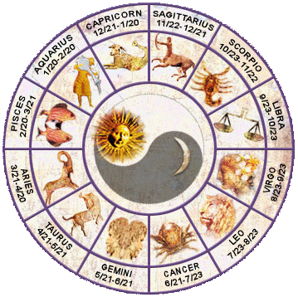
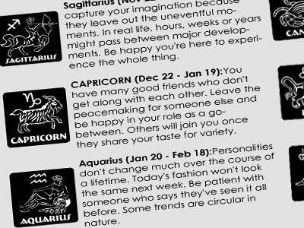
Horoscope... What´s your sign?

